Slide 1
BINARAY LOGISTIC REGRESSION INTRODUCTION

Slide 2
Multiple Linear Regression-Quick Recap
Multiple linear regression is used to explain the relationship between one continuous dependent variable and two or more independent variables.
The independent variables can be continuous or categorical.
Multiple Linear Regression is used when we want to predict the value of a variable based on the values of two or more other variables.
The variable we want to predict is called the dependent variable
The variables used to predict the value of dependent variable are called independent variables (or explanatory variables/predictors).
Example: The price house in USD can be dependent variable and area of house, location of house , air quality index in the area, distance from airport etc. can be independent variables.
$$Model : Y= b_{0}+b_{1}X_{1}+b_{2}X_{2}+ … +b_{p}X_{p}+e$$

Slide 3
Binary Logistic Regression
DEPENDENT VARIABLE
INDEPENDENT VARIABLES
Categorical (Binary)
Categorical or Continuous
0 or 1
Death or Survival
Absence or Presence
Gender
Geographical Regions
Age
Income
Debt Ratio
…..
…..
Binary logistic regression models the dependent variable as a logit of p, where p is the conditional probability that dependent variable takes value 1

Slide 4
Application Areas
Industry/Function
Objective
Based on Information such as:
Marketing Analytics
Identify the potential customers who will buy the product
Age, Gender, Payment Mode, Purchase Frequency, Historical purchase details, etc.
Churn Management
Identify the employees who are likely to leave the company
Gender, Qualification, Source of Hiring, Department, Compensation, etc.
Risk Management (Credit Scoring/ Fraud Detection)
Predict defaulters
Age, occupation, annual income, other loan details etc.
Insurance
Predict policy Lapse
Age, Gender, occupation, premium amount etc.

Slide 5

Why Not Use Linear Regression Model?
The statistical model for multiple linear regression is,
$$Y= b_{0}+b_{1}X_{1}+b_{2}X_{2}+ … +b_{p}X_{p}+e$$
If binary variable Y is used on left hand side of the model, then the two sides are not comparable. Right hand side is a continuous term.
If probability ‘P’ is used instead of Y then linearity may not hold true. The relationship assumed in logistic regression is a ‘S’ shaped curve.

Slide 6
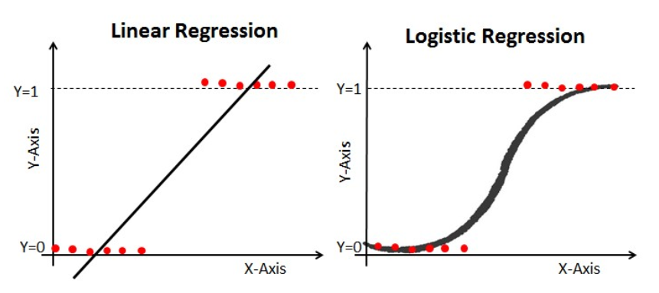
Why Not Use Linear Regression Model?
Linear regression is suitable for predicting outcome which is continuous value.
For example, predicting the price of a property based on area in Sq. Feet.
The regression line is a straight line.
Whereas logistic regression is for classification problems, which predicts a probability range between 0 to 1 (or predicts categories Yes or no).
For example, predict whether a customer will make a purchase or not.
The regression curve is a sigmoid curve.

Slide 7
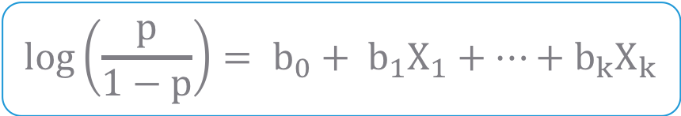
Statistical Model – For k Predictors
$$log\left(\frac{p}{1−p}\right)= b_{0}+ b_{1}X_{1}+…+b_{k}X_{k}$$
where,
p : Probability that Y=1 given X
Y : Dependent Variable
X₁, X₂ ,…, X_{k} : Independent Variables
b₀, b₁ ,…, b_{k} : Parameters of Model
Note that LHS of the model can lie between - ∞ to ∞
Parameters of the model are estimated by Maximum Likelihood Method

Slide 8
Case Study – Modeling Loan Defaults
Background
Objective
Available Information
A bank possesses demographic and transactional data of its loan customers. If the bank has a model to predict defaulters it can help in loan disbursal decision making.
To predict whether the customer applying for the loan will be a defaulter or not.
Independent Variables: Age group, Years at current address, Years at current employer, Debt to Income Ratio, Credit Card Debts, Other Debts. The information on predictors was collected at the time of loan application process.
Sample size is 700
Dependent Variable: Defaulter (=1 if defaulter ,0 otherwise). The status is observed after loan is disbursed.

Slide 9
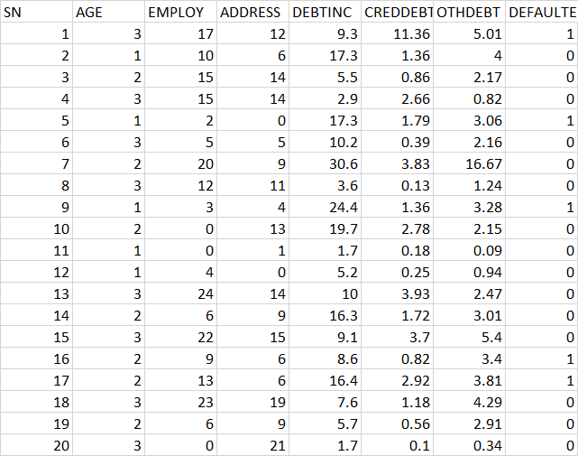
Data Snapshot
Bank Loan Data
Independent Variables
Dependent Variable
Column | Description | Type | Measurement | Possible Values
SN | Serial Number |  | - | -
AGE | Age Groups | Categorical | 1(<28 years), 2(28-40 years), 3(>40 years) | 3
EMPLOY | Number of years customer working at current employer | Continuous | - | Positive value
ADDRESS | Number of years customer staying at current address | Continuous | - | Positive value
DEBTINC | Debt to Income Ratio | Continuous | - | Positive value
CREDDEBT | Credit Card Debt | Continuous | - | Positive value
OTHDEBT | Other Debt | Continuous | - | Positive value
DEFAULTER | Whether customer defaulted on loan | Binary | 1(Defaulter), 0(Non-Defaulter) | 2
Observations

Slide 10
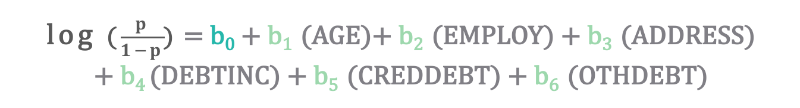
Binary Logistic Regression Model for the bank loan data
Model of default on the predictors will look like this:
Where p is the Probability of Dependent Variable = 1 (here, Default=1)
Intercept
Independent Variables
log ($\frac{p}{1−p}$) = b₀ + b₁ (AGE)+ b₂ (EMPLOY) + b₃ (ADDRESS)
+ b₄ (DEBTINC) + b₅ (CREDDEBT) + b₆ (OTHDEBT)
Parameter Estimates

Slide 11

Likelihood Function
The parameters of the logistic model are estimated using maximum likelihood estimation (MLE).
The Likelihood function is as below:
The likelihood function is a joint probability of Yi's.
It is expressed as a function of regression parameters after substituting known X and Y value.
Parameters are estimated by maximizing L.
Two commonly used iterative maximum likelihood algorithms are Fisher scoring method and Newton-Raphson method. Both algorithms give the same parameter estimates; however, the estimated covariance matrix of the parameter estimators can differ slightly.
L =
n is the number of observations

Slide 12
Maximum Likelihood Estimates of Parameters
 | Coefficients
Intercept | -0.78821
AGE2 | 0.25202
AGE3 | 0.62707
EMPLOY | -0.26172
ADDRESS | -0.09964
DEBTINC | 0.08506
CREDDEBT | 0.56336
OTHDEBT | 0.02315
log ((p/(1-p)) = -0.78821+ 0.25202 (AGE2)+ 0.62707 (AGE3)
-0.26172 (EMPLOY) - 0.09964 (ADDRESS) + 0.08506(DEBTINC) + 0.56336(CREDDEBT) + 0.02315 (OTHDEBT)

Slide 13
Individual testing using Wald’s test
Individual testing is used for checking significance of each independent variable separately.
Objective | To test the null hypothesis that each variable is insignificant
Null Hypothesis (H₀): b_{i} = 0
Alternate Hypothesis (H₁): : bi ≠ 0
i=1,2…,k
Test Statistic | Z =(Estimate of bi)/(Standard Error of estimated bi) Under H0, Z is assumed to follow standard normal distribution.
Decision Criteria | Reject the null hypothesis if p-value < 0.05

Slide 14
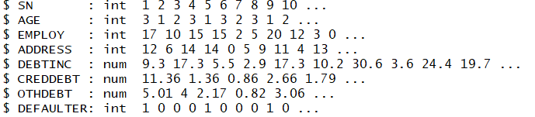
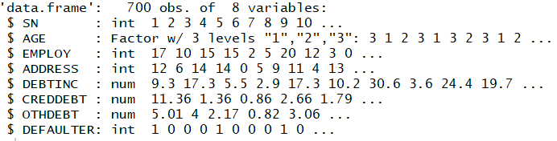
Binary Logistic Regression in R
# Import data and check data structure before running model
data<-read.csv("BANK LOAN.csv",header=TRUE) str(data)
# Output:
Age is an integer and need to convert into factor. Since, it is a categorical variable.
data$AGE<-factor(data$AGE) str(data)
# Output:

Slide 15
Logistic Regression in R
# Using glm function to develop binary logistic regression model
riskmodel<-glm(DEFAULTER~AGE+EMPLOY+ADDRESS+DEBTINC+CREDDEBT+OTHDEBT, family=binomial,data=data)
glm is Generalized Linear Model. Logistic regression is type of GLM.
LHS of ~ is dependent variable and independent variables on RHS are separated by ‘+’.
riskmodel is the model object
By setting the family =binomial, glm() fits a logistic regression model

Slide 16
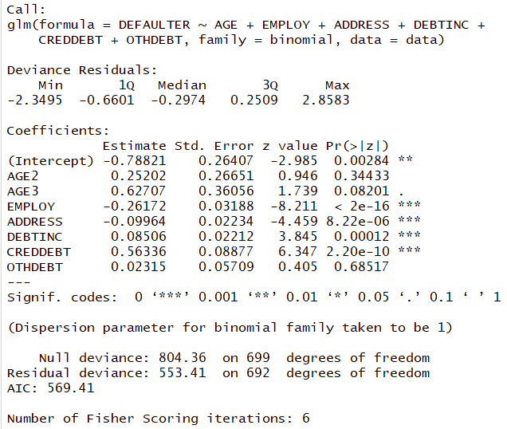
Individual Hypothesis Testing in R
# Individual Testing
summary() function gives the output of glm.
summary(riskmodel)
# Output:
Interpretation :
Since p-value is <0.05 for Employ, Address, Debtinc, Creddebt, these independent variables are statistically significant.

Slide 17
Re-run Model in R
Once variables to be retained are finalized ,re-run the model with these final variables and obtain revised coefficients for the model.
Re-run the model with employ, address, debtinc, creddebt.
riskmodel<-glm(DEFAULTER~EMPLOY+ADDRESS+DEBTINC+CREDDEBT, family=binomial,data=data) summary(riskmodel)

Slide 18
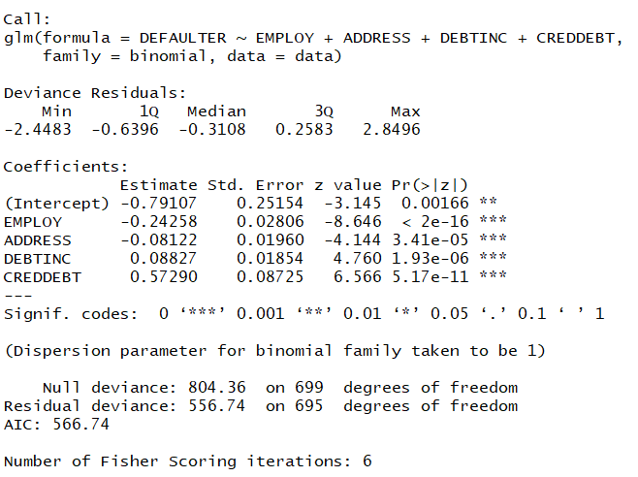
Re-run Model in R
# Output:
Interpretation :
Since p-value is <0.05 for Employ, Address, Debtinc, Creddebt, these independent variables are significant and sign of the coefficients are also logical.

Slide 19
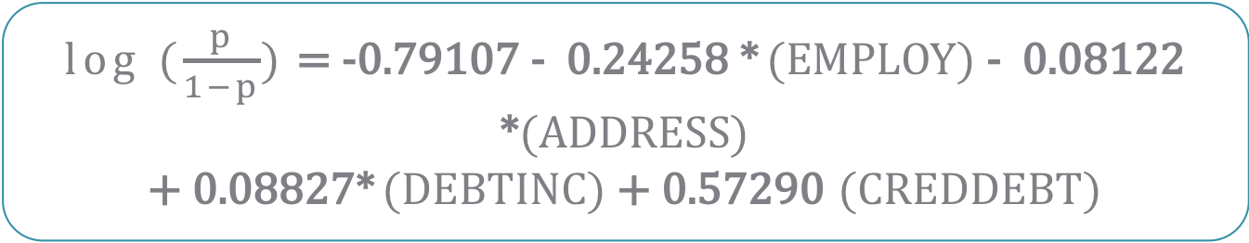
Final Model
Final Model is :
This model is used for predicting the probabilities.
log ($\frac{p}{1−p}$) = -0.79107 - 0.24258 * (EMPLOY) - 0.08122 *(ADDRESS)
+ 0.08827* (DEBTINC) + 0.57290 (CREDDEBT)

Slide 20
Predicting Probabilities in R
# Predicting Probabilities
data$predprob<-round(fitted(riskmodel),2) head(data,n=10)
fitted function generates the predicted probabilities based on the final riskmodel.
round function helps rounding the probabilities to 2 decimal
data$predprob: Predicted probabilities are saved in the same dataset ‘data’ in new variable ‘predprob’.

Slide 21
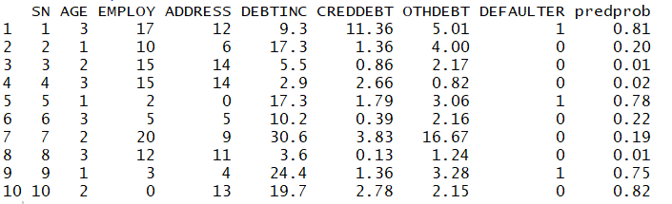
Predicting Probabilities in R
# Output:
Interpretation :
Last column in the data ‘predprob;’ is the probabilities generated using final model.

Slide 22
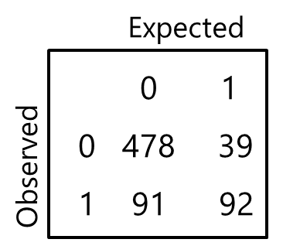
Classification Table
Based on cut-off value of p, Y is estimated to be either 1 or 0
Ex. p>0.5 ; Y=1
p≤0.5 ; Y=0
Cross tabulation of observed values of Y and predicted values of Y is called as Classification Table.
The predictive success of the logistic regression can be assessed by looking at the classification table, but classification table is not always a good measure of goodness fit since it varies with the cut off value set.
Accuracy Rate measures how accurate a model is in predicting outcomes.
In the adjoining table, 479 times Y=0 was observed as well as predicted. Similarly, Y=1 was observed and predicted 92 times.
Accuracy Rate = (479+92)/700 = 81.57
479
38

Slide 23
Misclassification
Misclassification Rate → Percentage of wrongly predicted observations
Note that misclassification rate depends on cut off used for predictions
Suppose our classification table looks as follows:
Here misclassification rate is : (38 +91) / 700=18.43%
479
38

